Slide 1
Project PAVECOM
Planning Autonomous Vehicle expedition using Convex Optimization
Cullen Dahleen, Steve Hannah, Nick Johnson and Bri Meyer

Slide 2
1
Background and Motivation
Bri Meyer

Slide 3
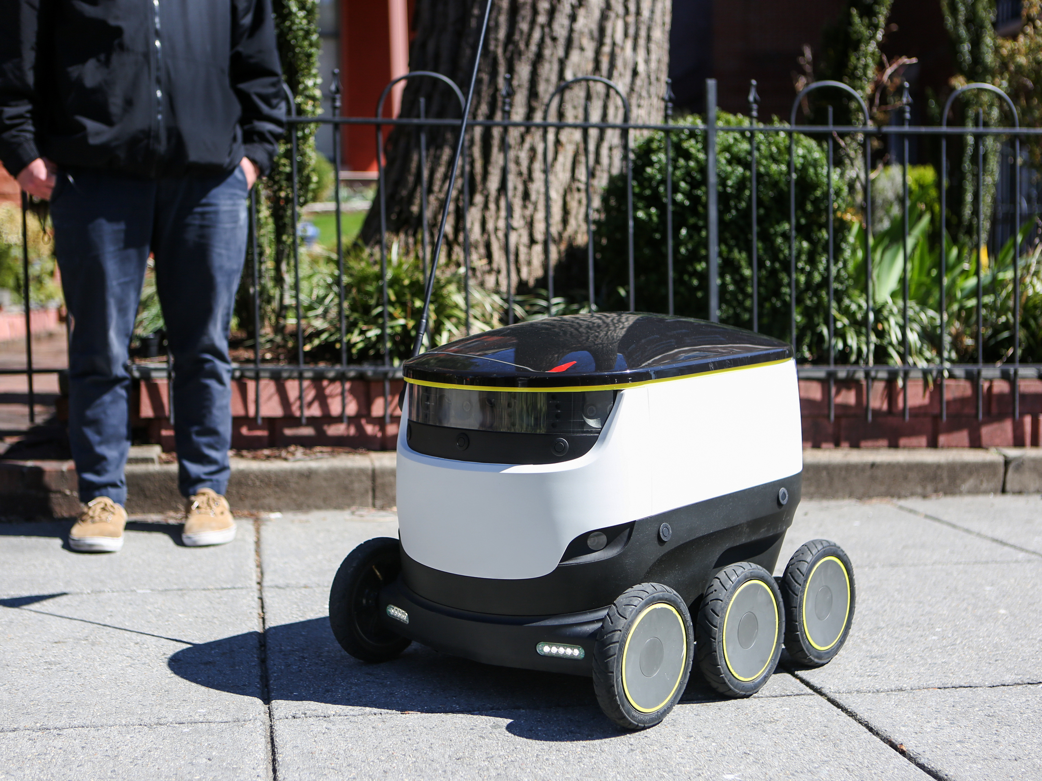
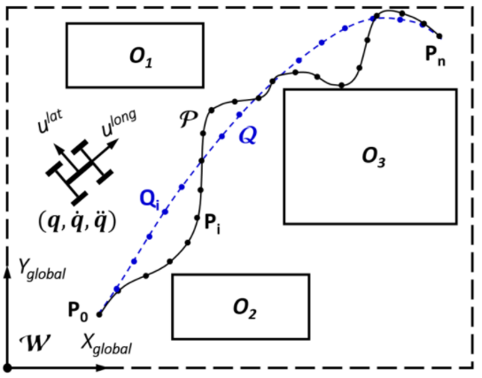

Background & Motivation
Autonomous vehicles are viable solutions for many issues today
Route-planning algorithms for known maps are often jagged and inefficient
Convex optimization methods can smooth and shorten these trajectories for better speed and vehicle performance
Source: MPRNews
Source: Adapted from [1]

Slide 4
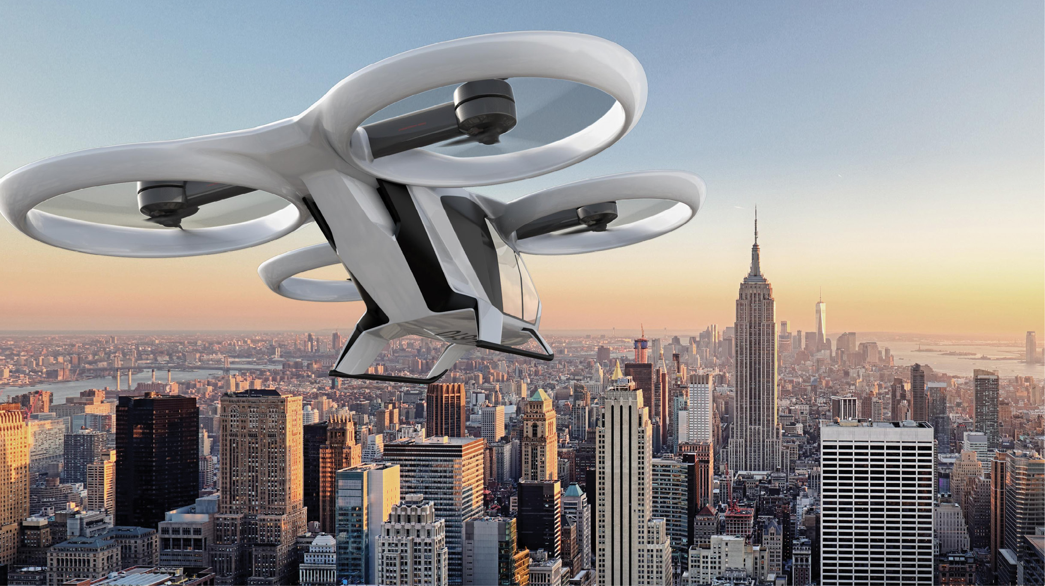
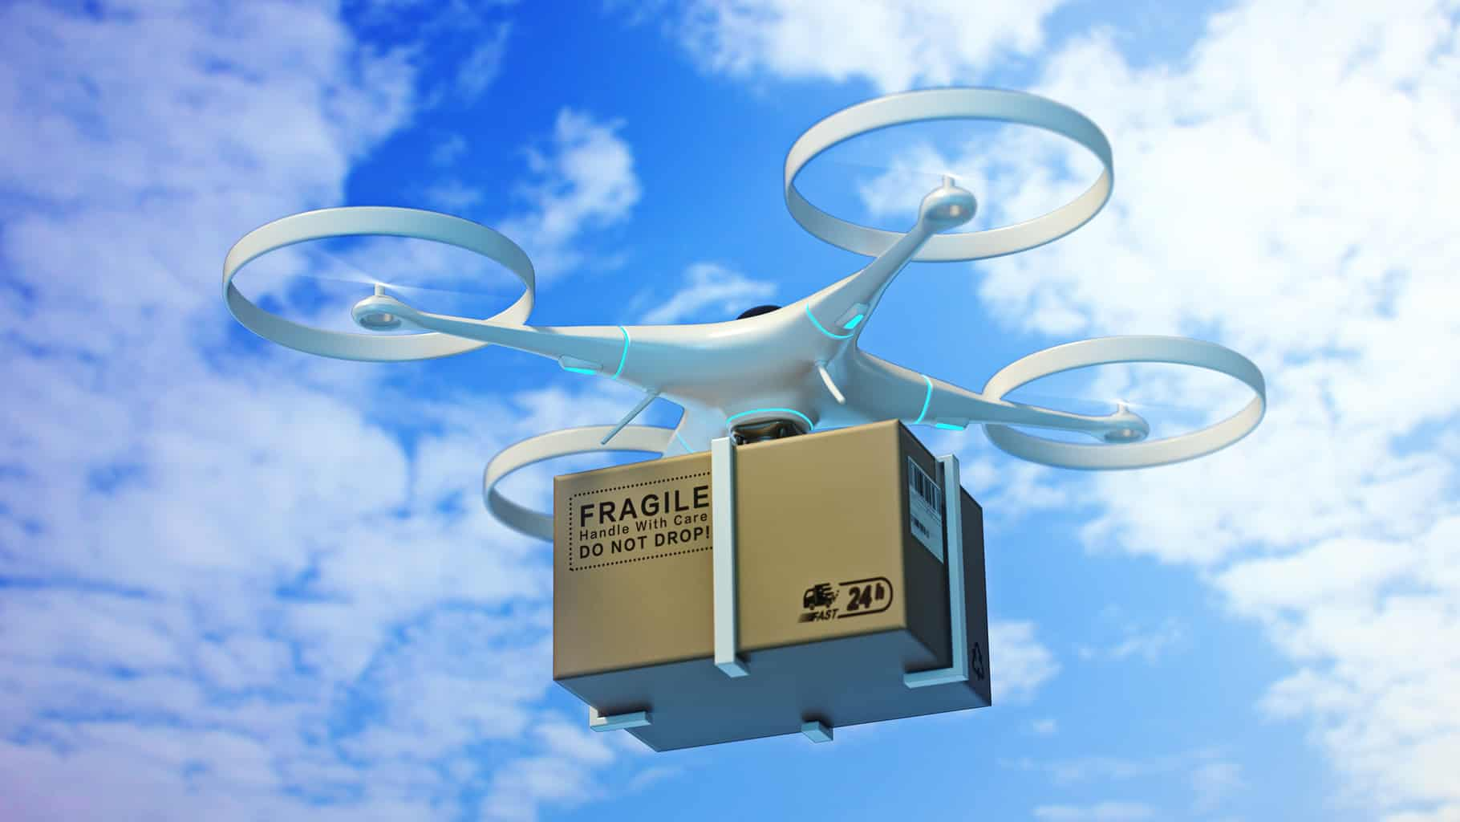
Background & Motivation
Trajectory planning & optimization can be used in aerospace applications
Urban Air Mobility
Last Mile Delivery
Little work has been done to apply these methods to 3D spaces
Source: Airbus
Source: iStock

Slide 5
Objective
Expand upon previously developed algorithms for 2D spaces to demonstrate route planning and trajectory optimization in a 3D environment for unmanned and autonomous air vehicle applications.

Slide 6

2
Path Planning Algorithm
Steve Hannah

Slide 7
Path Planning Algorithm – RRT*
The RRT* Algorithm
For this project, the Rapidly-Exploring Random Trees (RRT*) Algorithm was chosen due to is variability
Inputs/Outputs:
Input: Environment – Terrain, Starting Position, Goal, Obstacle
Input: Tuning Parameters – Number of Randomly Generate Points, Step Size, Obstacle Buffer, Number of Interpolated Path Points
Output: Optimal Path
Algorithm:
Generate Random Node
Find Existing Node closest to the Random Node
Check for Collision between the Closest Node to the Random Node
If No Collision, take a step towards the Random Node and Create New Node
Once all Random Nodes have been Generated, Build Optimal Path

Slide 8
Path Planning Algorithm – RRT*
Randomly Generated Node
Goal Node
Proposed New Node
Defined Step Size
Existing Nodal Network
Starting Node

Slide 9
Path Planning Algorithm – RRT*
Results
Successfully navigates from the starting point to the goal without colliding with the obstacle
Features:
Random Points (blue x’s)
Nodal Network (black line)
Optimal Path (red line)
Outputs the Optimal Path to Downstream Functions
Optimal Path is interpolated to increase number of points

Slide 10
3
Bubble Algorithm
Cullen Dahleen

Slide 11
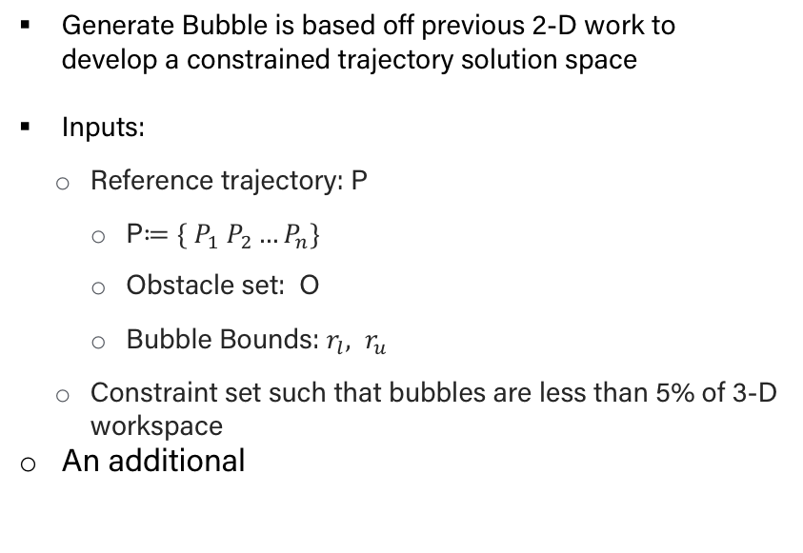
Bubbles & Cube Algorithim
Bubble Generation
Generate Bubble is based off previous 2-D work to develop a constrained trajectory solution space
Inputs:
Reference trajectory: P
P$≔\{ P_{1} P_{2}…P_{n}\}$
Obstacle set: O
Bubble Bounds: $r_{l},$ $r_{u}$
Constraint set such that bubbles are less than 5% of 3-D workspace
An additional

Slide 12
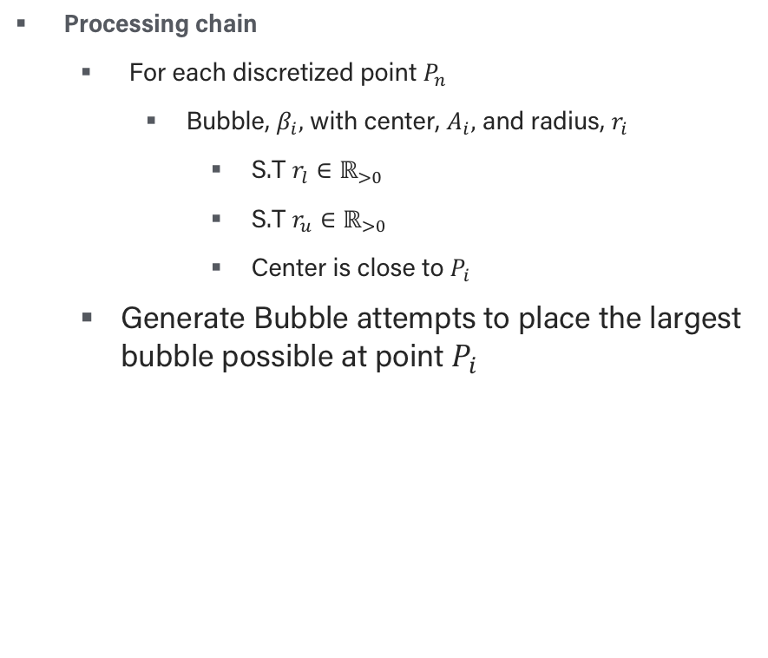
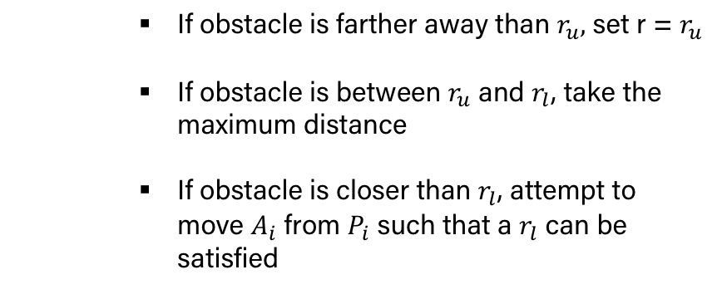
Bubbles & Cube Algorithim
Processing chain
For each discretized point $P_{n}$
Bubble, $β_{i},$ with center, $A_{i},$ and radius, $r_{i}$
S.T $r_{l}∈ℝ_{>0}$
S.T $r_{u}∈ℝ_{>0}$
Center is close to $P_{i}$
Generate Bubble attempts to place the largest bubble possible at point $P_{i}$
If obstacle is farther away than $r_{u},$ set r = $r_{u}$
If obstacle is between $r_{u}$ and $r_{l}$, take the maximum distance
If obstacle is closer than $r_{l}$, attempt to move $A_{i}$ from $P_{i}$ such that a $r_{l}$ can be satisfied

Slide 13
Optimization – Algorithim, objective function
Subhead Acumin Pro Semi Cond Bold 22 pt
Bulleted copy. Acumin Pro Reg 18 pt. Keep it short with bite-size chunks of information.
Bulleted copy. Acumin Pro Reg 18 pt. Keep it short with bite-size chunks of information.
Bulleted copy. Acumin Pro Reg 18 pt. Keep it short with bite-size chunks of information.
Bulleted copy. Acumin Pro Reg 18 pt. Keep it short with bite-size chunks of information.

Slide 14
Results
Subhead Acumin Pro Semi Cond Bold 22 pt
Bulleted copy. Acumin Pro Reg 18 pt. Keep it short with bite-size chunks of information.
Bulleted copy. Acumin Pro Reg 18 pt. Keep it short with bite-size chunks of information.
Bulleted copy. Acumin Pro Reg 18 pt. Keep it short with bite-size chunks of information.

Slide 15
Brief photo caption. Place in top left or right corner. Acumin Pro Bold 18 pt. Make text black or white for legibility.

Slide 16
123
TOPIC OR TITLE
Fact or highlight. Acumin Pro Medium 24 pt. Keep it short with bite-size chunks of information.

Slide 17
Thank You
Conclusion, call to action or contact information. Acumin Pro Reg 18 pt. Keep it short with bite-size chunks of information.

Slide 18
References
[1] Zhijie Zhu, Edward Schmerling, and Marco Pavone. A convex optimiza-tion approach to smooth trajectories for motion planning with car-likerobots. In2015 54th IEEE Conference on Decision and Control (CDC),pages 835–842. IEEE.

Slide 19
Image Sources
Delivery Robot (slide 2): https://www.mprnews.org/story/2017/03/23/npr-hungry-call-your-neighborhood-delivery-robot
Urban Air Mobility Aircraft (slide 3): https://www.airbus.com/newsroom/stories/urban-air-mobility-the-sky-is-yours.html
Last Mile Delivery Aircraft (slide 3): https://www.istockphoto.com/photo/drones-carry-express-packages-in-the-sky-npackages-are-transported-in-high-tech-gm1021718756-274367945

